Slide 1

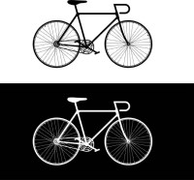
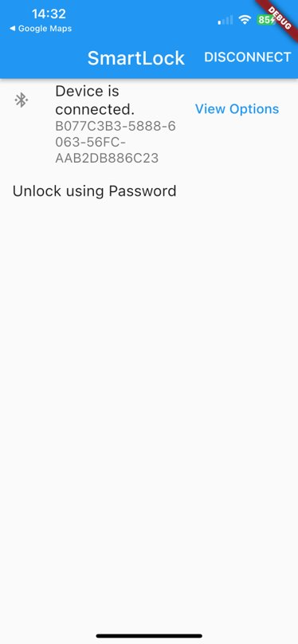
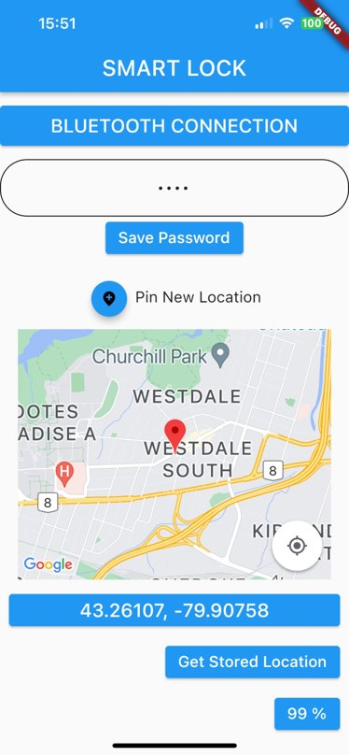
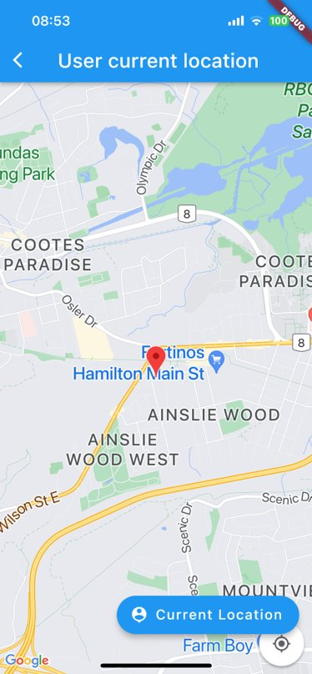
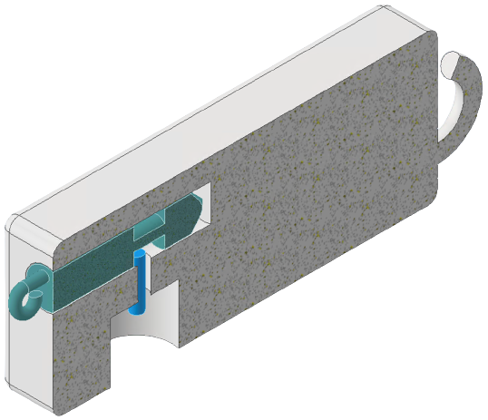

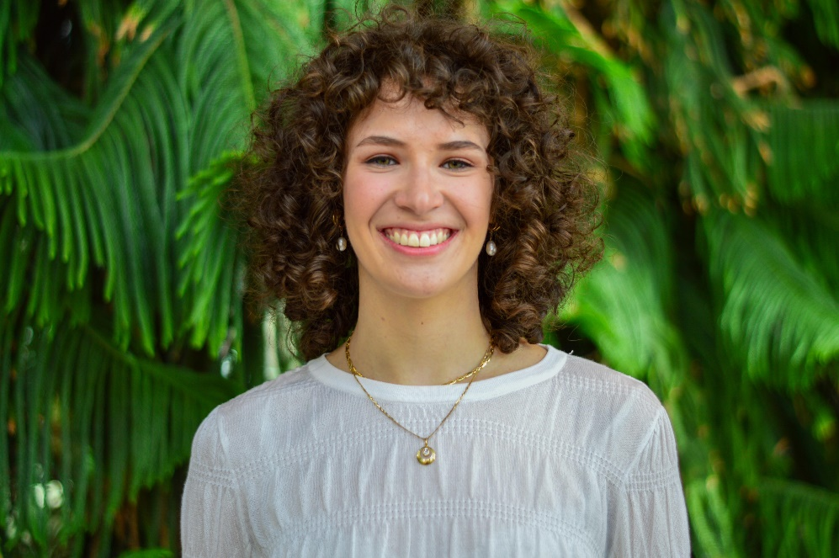
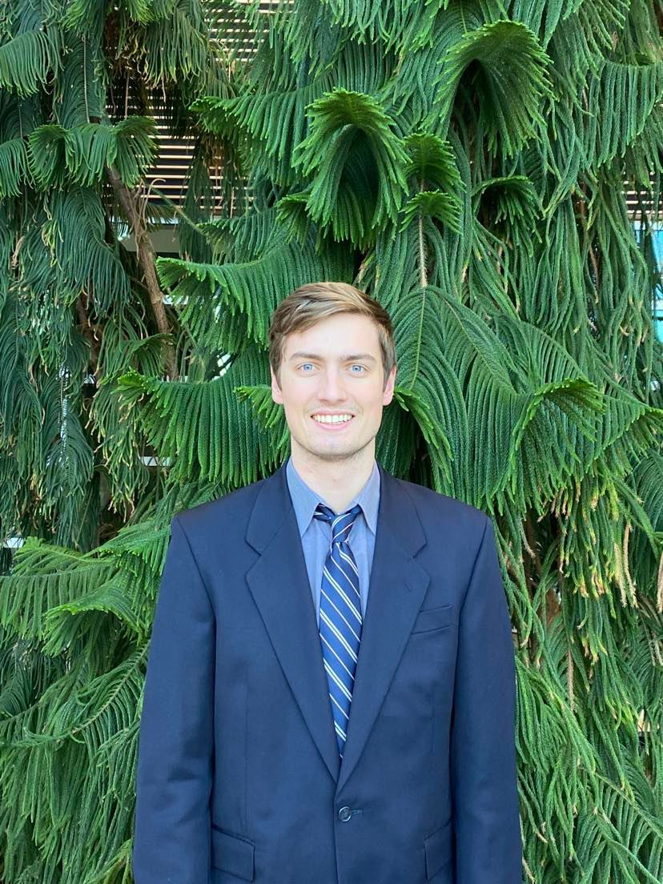
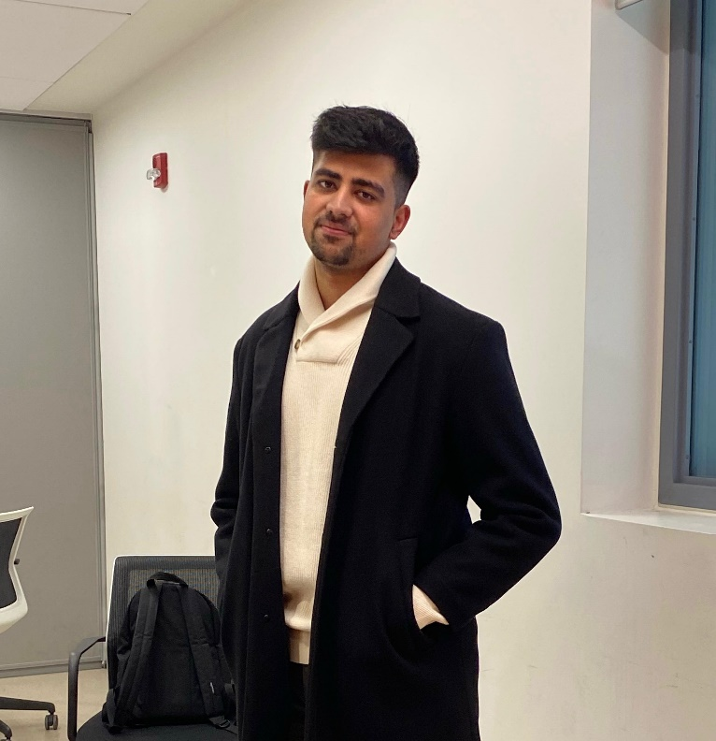
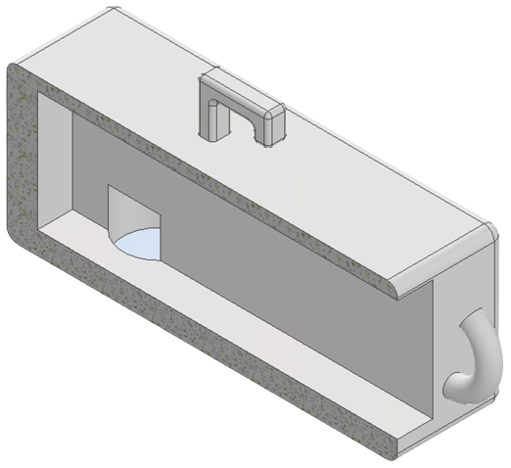
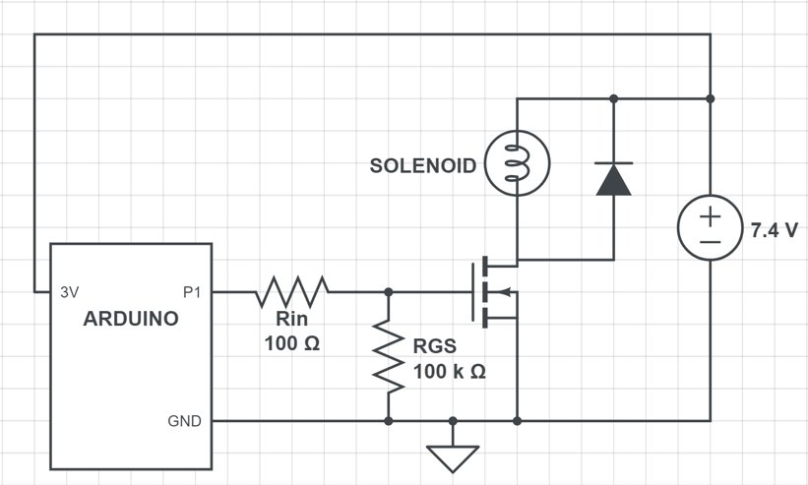
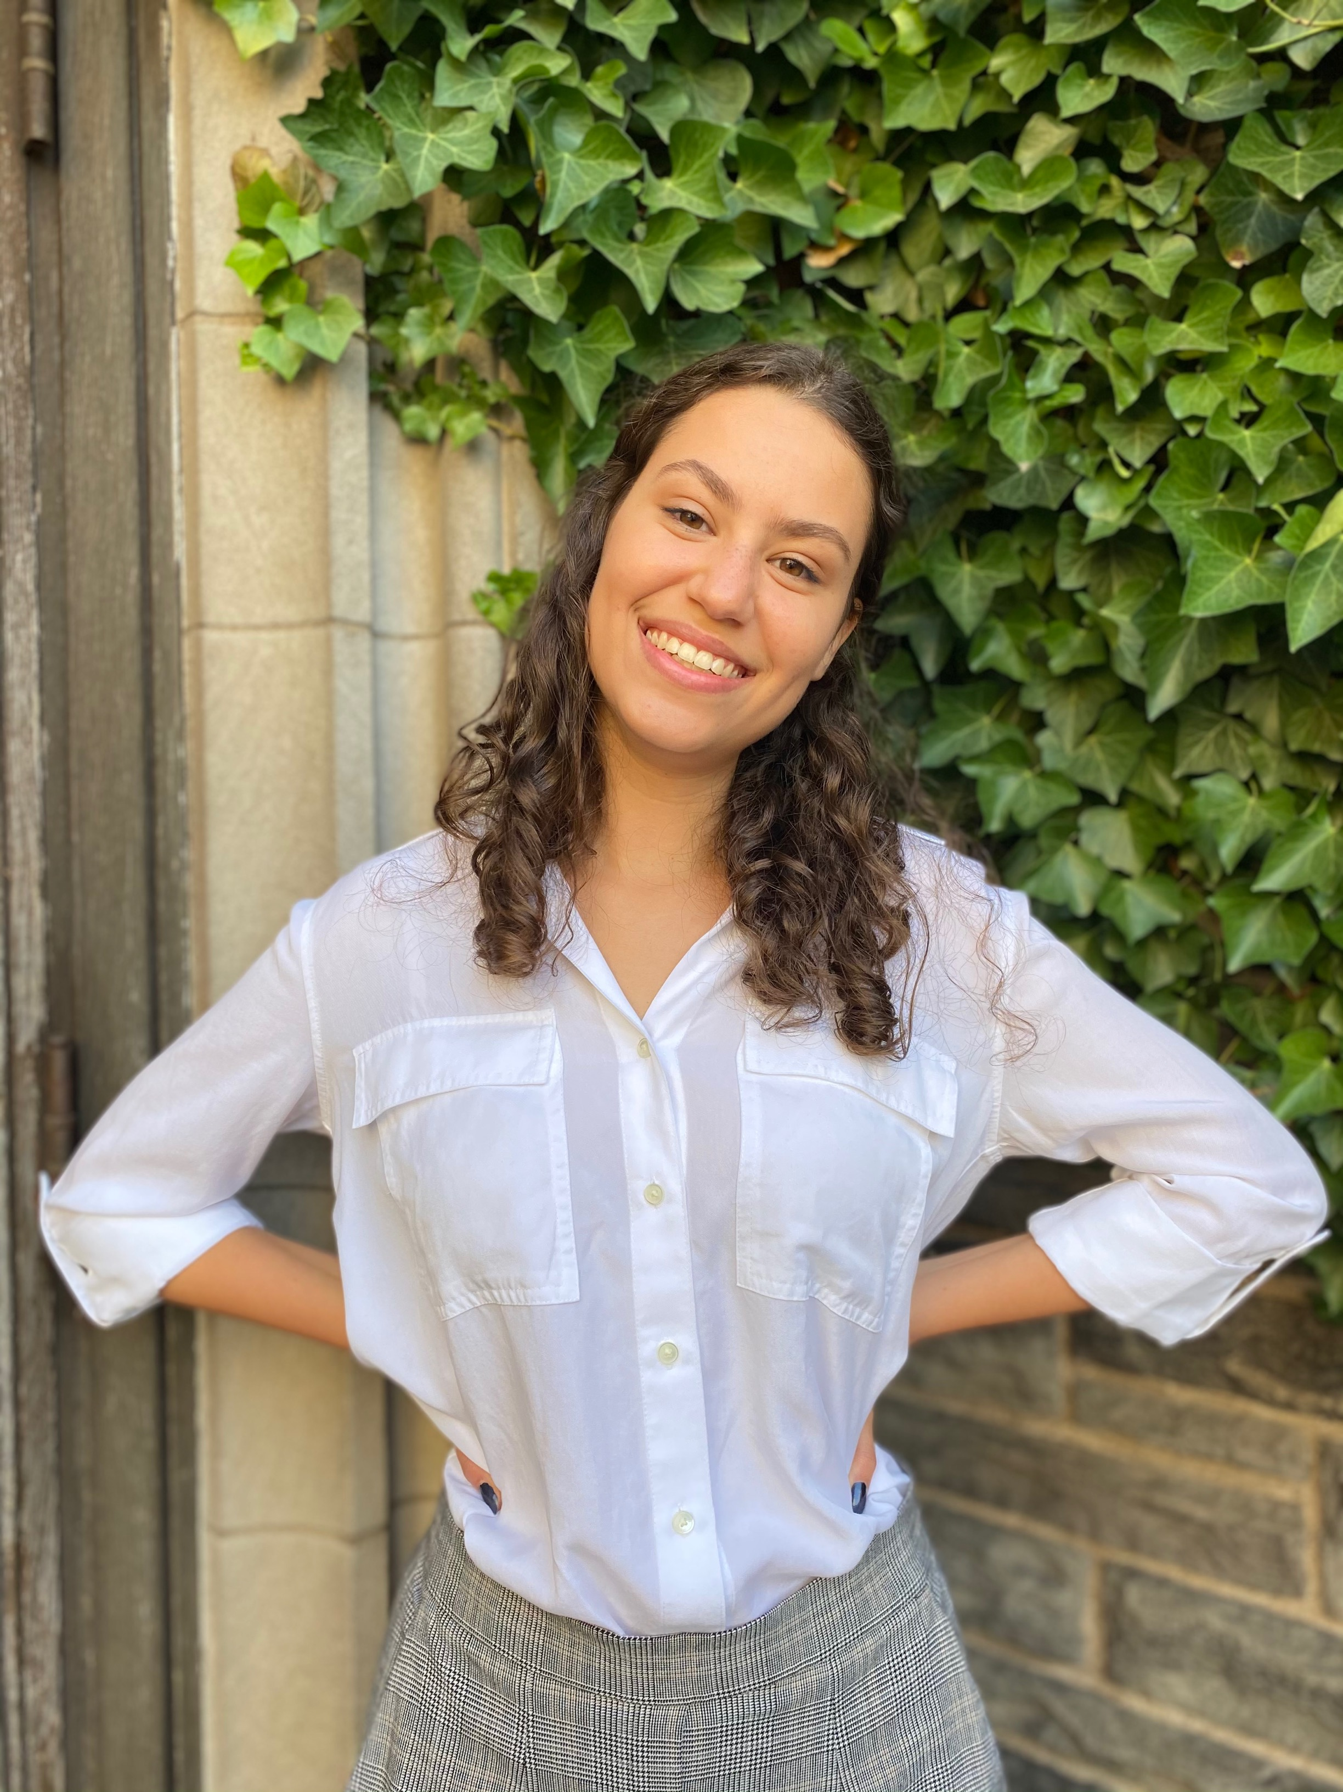
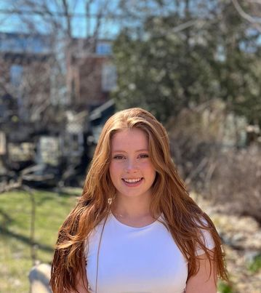
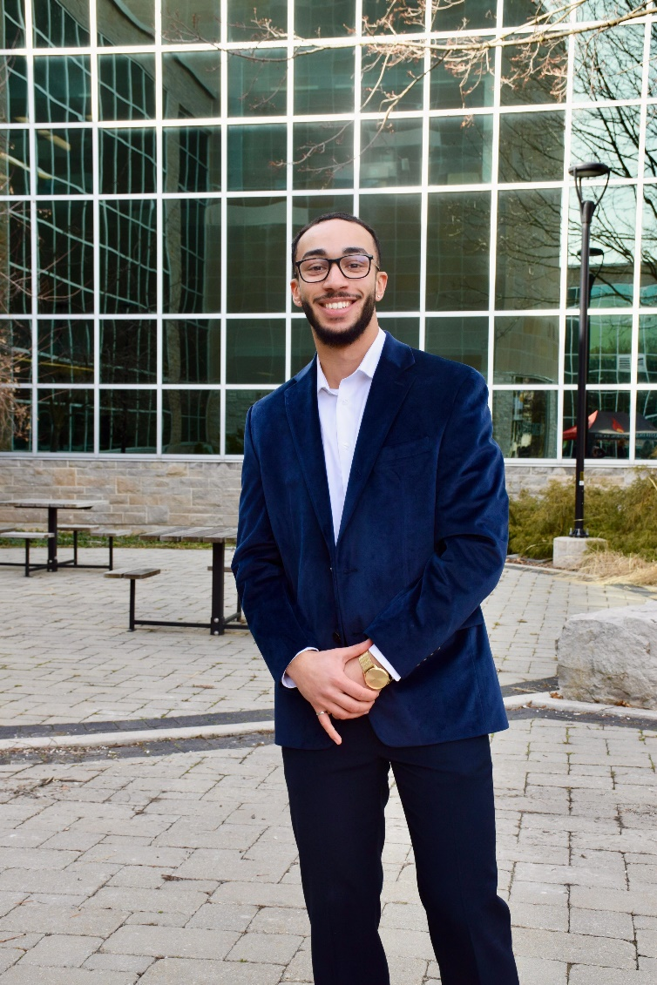







SmartLock
Mechatronics & Software Engineering Capstone
Department of Computing and Software
PROBLEM STATEMENT
UNLOCK FEATURE
APP HOMEPAGE
GEOTAG FEATURE
UNLOCKING STEPS
Students ride bicycles as a primary mode of transportation. They are easy to use, relatively cheap, are a great source of exercise and can allow one to spend time outdoors. They can help students commute to school quicker than public transportation, which can often be unreliable or crowded. However, there are some barriers to biking, the most important being theft because bikes are easy to steal and can be sold for parts. To protect a bike from being stolen, a lock can be used. However, locks can be bulky, heavy, slow and difficult to use, especially if they are not mounted directly on the bike. Furthermore, an individual can forget where they left their bike, needing a way to locate it. Therefore, we have designed and built the SmartLock, a smartphone application-controlled bicycle lock that disengages automatically with the touch of a button and is mountable to any bike.
Connect to SmartLock from the app via Bluetooth and send disengage signal
Arduino receives disengage signal and circuit disengages solenoid
Solenoid actuates, pulling back the small locking pin and disengaging the physical locking mechanism
GEOTAGGING STEPS
Press "Pin New Location" on Home Screen
Press "Current Location" on Save Location screen
To get stored location:
Press "Get Stored Location“ on Home Screen
Optionally, copy coordinates to get directions to tagged location
PRODUCT FEATURES
1
Securely lock bike to external frame
Automatic disengagement mechanism from smartphone – 10s delay until re-engagement to secure lock
Geotag parked location
Interactive, moveable map
Coordinate copying to pair with GPS software (Google or Apple Maps) for directions
Password protection
Simple mounting onto bicycle frame
Flexible and sturdy chain to attach lock to external bike rack
Battery status display on smartphone
Bluetooth Connect
Home Screen
Save Location
OUR TEAM
3
Elsa Bassi
Mechatronics Engineering
Stephen De Jong
Mechatronics Engineering
& Management
Abdul Iqbal
Mechatronics Engineering
2
TOOLS USED
Abi Nevo
Mechatronics Engineering
Steffi Ralph
Mechatronics Engineering
& Management
Anthony Shenouda
Mechatronics Engineering
& Management
ACKNOWLEDGEMENTS
We would like to thank Dr. Smith, Dr. Sirouspour, and the wonderful MECHTRON 4TB6 Teaching Assistants for their encouragement, feedback, and support throughout the duration of this project.

